Slide 1
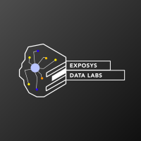
INTERNSHIP PROJECT PRESENTATION
By- Ahana Drall and Suyash Kumar

Slide 2

PROBLEM STATEMENT
To apply K-means clustering and visualising age and gender distribution along with analysing the annual income and spending scores.

Slide 3
LIBRARIES AND THEIR VERSIONS USED
Pandas- version 1.0.1
Matplotlib- version 3.1.3
Sklearn- version 0.22.1

Slide 4
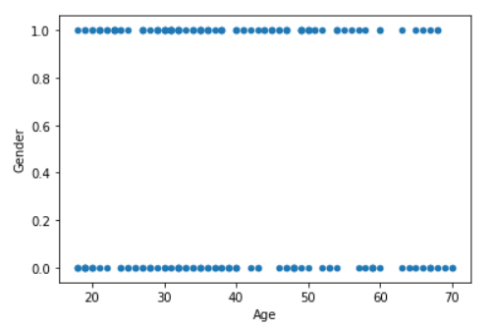
AGE v/s GENDER SCATTERPLOT
The following diagram shows the scatterplot between age and gender.

Slide 5
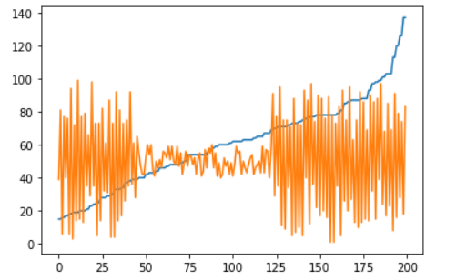
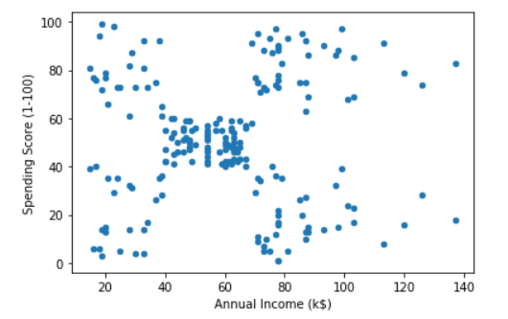
ANNUAL INCOME v/s SPENDING SCORE
The first plot shows the line plot between annual income and spending score.
The second plot shows the scatter plot between annual income and spending score.
Line Plot
Scatter Plot

Slide 6
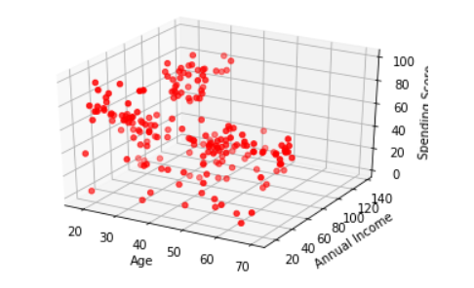
AGE v/s ANNUAL INCOME v/s SPENDING SCORE
This plot shows the 3- Dimensional plot between age, annual income and Spending score

Slide 7
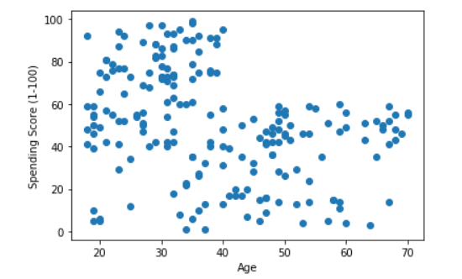
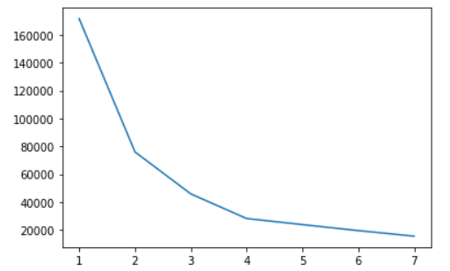
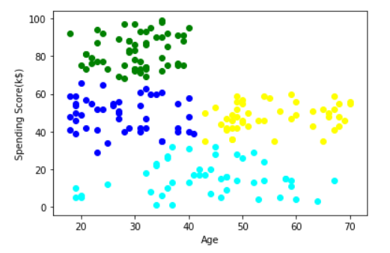
CLUSTERING BASED ON AGE AND SPENDING SCORE
Applying K-means clustering to age and spending score
The elbow curve shows that the value of k here is 4 and hence we have used the information for making the clusters using this value.

Slide 8
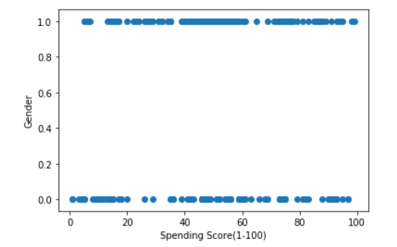
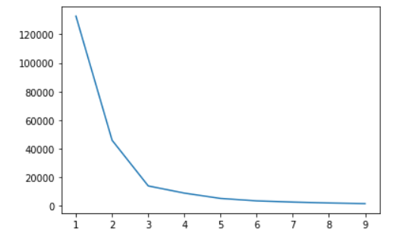
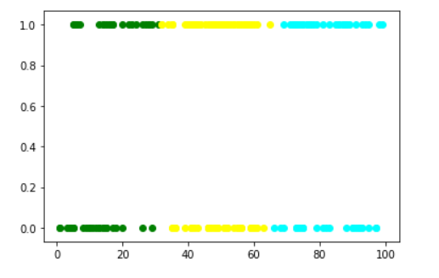
CLUSTERING BASED ON GENDER AND SPENDING SCORE
Applying K-means clustering to Gender and spending score
The elbow curve shows that the value of k here is 3 and hence we have used the information for making the clusters using this value.

Slide 9
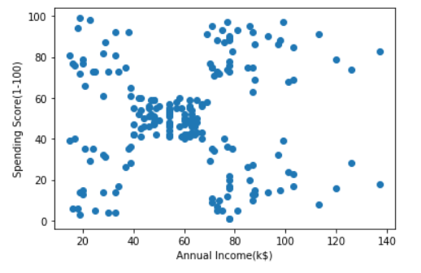
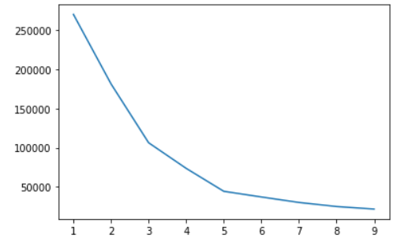
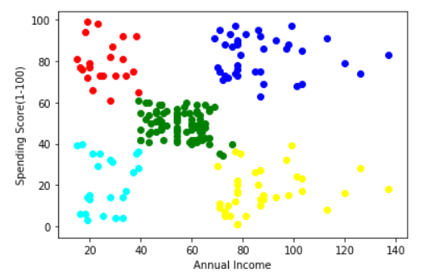
CLUSTERING BASED ON ANNUAL INCOME AND SPENDING SCORE
Applying K-means clustering to annual income and spending score
The elbow curve shows that the value of k here is 5 and hance we have successfully sugmented the customers in five groups.

Slide 10
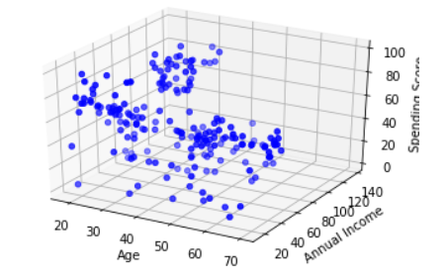
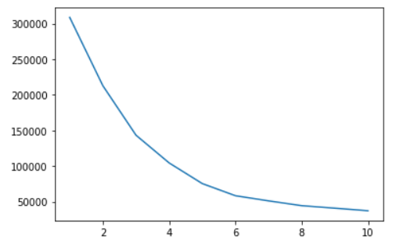
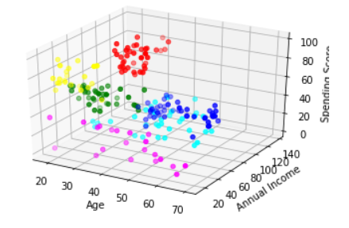
CLUSTERING BASED ON AGE, ANNUAL INCOME AND SPENDING SCORE
Applying K-means clustering to age, annual income and spending score
The elbow curve shows that the value of k here is 6 and we can clearly see 6 different clusters of customers

Slide 11

CONCLUSION
The companies should target their customers based on the clusters provided above. They should take care of the customers with high income and high spending scores, and also work towards the interest of the customers with high income, low spending scores and low income, high spending scores. Also, based on this segmentation the companies can provide personalised treatment to each of the segments.

